Slide 1


Leveling the Playing Field: Achieving Fairness in Machine Learning
Presented By:
Nitesh Dohre (2022MCS2070) Anurag Krishna Sharma (2022MCS2071)
Guided By:
Asso. Prof Aaditeshwar Seth

Slide 2
CONTENTS
Introduction
Types of Bias in Machine Learning
Why Fairness Matters
Addressing Bias in Machine Learning
Dataset 1 : Predicting a person have Diabetes or not
Dataset 2 : Criminal- Race
Conclusion

Slide 3
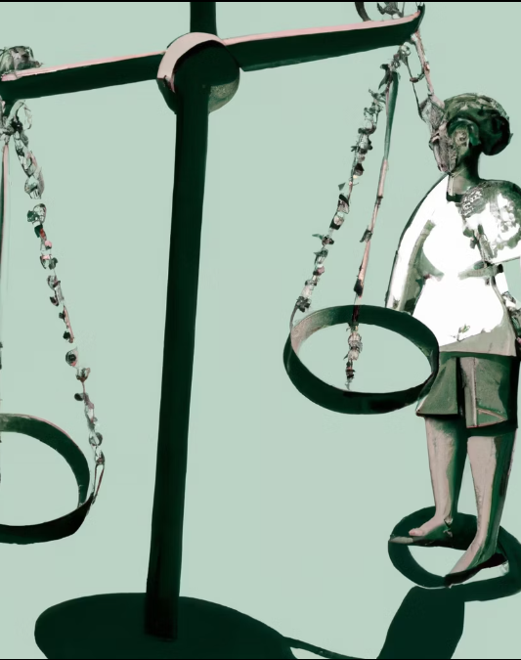
Introduction
Machine learning is becoming increasingly important in our daily lives, from personalized recommendations on Netflix and Amazon to self-driving cars. However, with the increasing use of machine learning algorithms, there is a growing concern about fairness.
Fairness in machine learning refers to the idea that the outcomes of machine learning algorithms should not be biased against certain groups of people based on their race, gender, age, or other protected characteristics.

Slide 4

Types of Bias in Machine Learning
There are several types of bias that can occur in machine learning algorithms. One type is selection bias, which occurs when the data used to train the algorithm is not representative of the population it will be applied to. This can lead to inaccurate or unfair predictions for certain groups of people.
Another type of bias is confirmation bias, which occurs when the algorithm reinforces existing stereotypes or prejudices. For example, if an algorithm is trained on data that shows men are more likely to be successful in certain industries, it may continue to make biased predictions even if the data changes over time.

Slide 5

Addressing Bias in Machine Learning
There are several approaches to address bias in machine learning. One approach is to improve the quality and representativeness of the data used to train the algorithm. This may involve collecting more diverse data or using techniques such as oversampling to ensure that underrepresented groups are adequately represented.
In this Assignment we have used following techniques:
Up sampling of data
Down sampling of data
Bliinding of sensitive attribute
Somewhere Reweighing

Slide 6
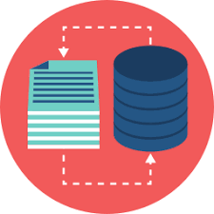
Dataset1 : DIABETES Dataset
This Dataset set record of peoples who have been tested for diabetes, have all record of all the factors (measures) requires for testing whether the patient is diagnosed with Diabetes or not.

Slide 7
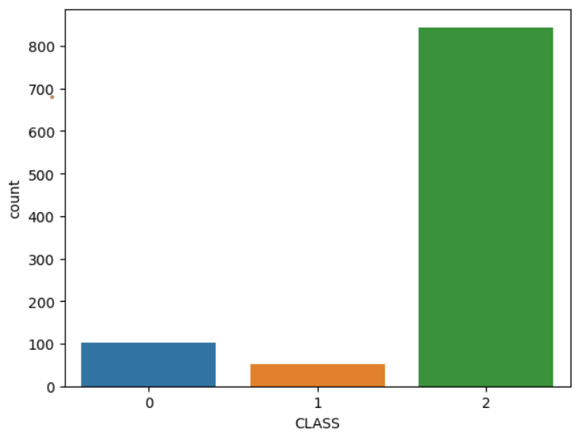
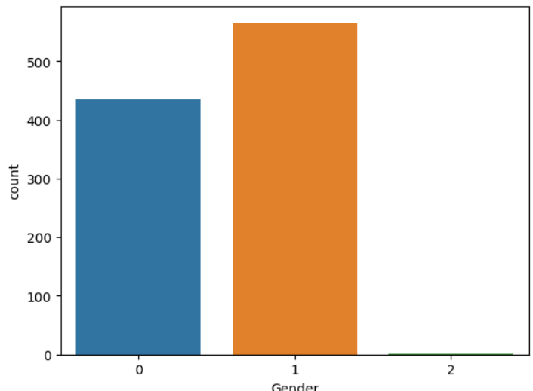
ANALYSING THE DATASET1:
After analyzing the dataset, it was observed that there is an uneven distribution of the attributes "class" and "gender". This means that there are significantly more samples belonging to one category than the other. This could potentially lead to biased results in any analysis or modeling performed on the dataset. It is important to address this imbalance before proceeding with any further analysis or modeling.

Slide 8
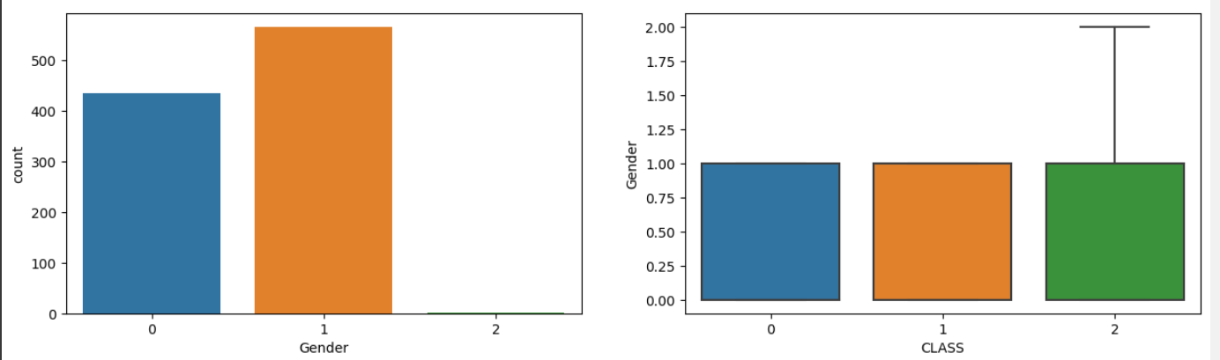
1-Factor analysis
Factor analysis is a statistical technique used to identify underlying dimensions or factors that explain the correlations among a set of observed variables.
RELATIONSHIP BETWEEN GENDER AND CLASS

Slide 9
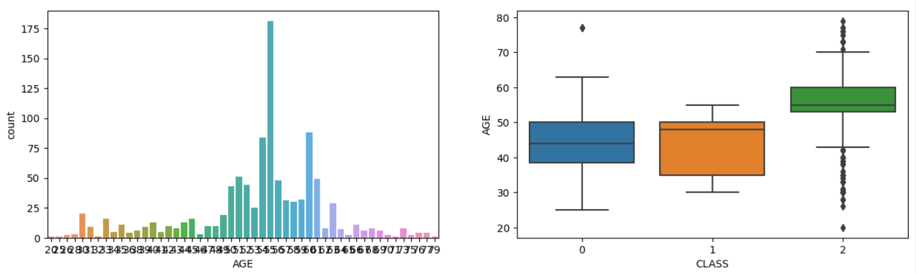
ReLATIONshIP BETWEEN AGE AND CLASS

Slide 10
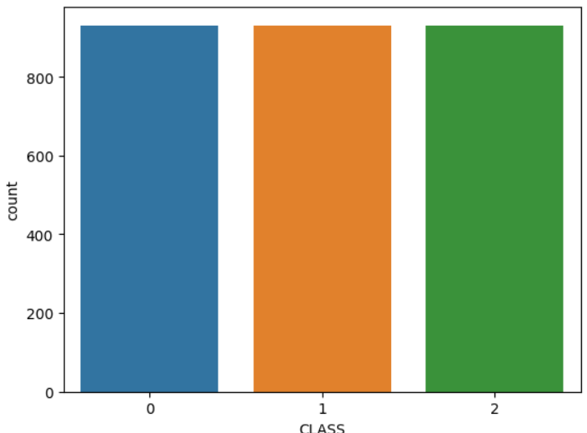
Measures to achieve Fairness
We used the ADASYN algorithm to address class imbalance by up-sampling the minority class. The approach avoids overfitting, improved model performance, and fairness. Other preprocessing techniques were also used.

Slide 11
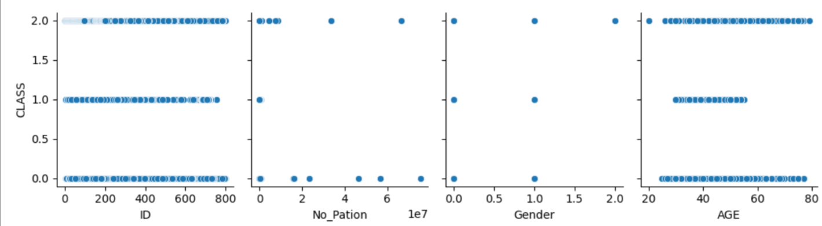
1-Factor Analysis after resampling

Slide 12
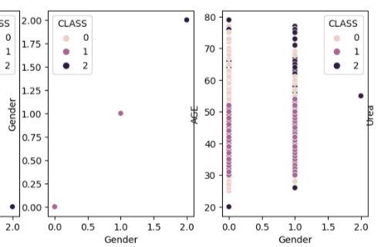
TWO FACTOR ANALYSIS
Two-factor analysis, also known as two-way analysis, is a statistical method used to analyze the effects of two independent variables, or factors, on a dependent variable.

Slide 13
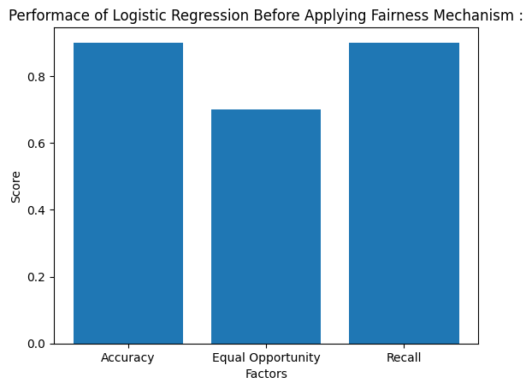
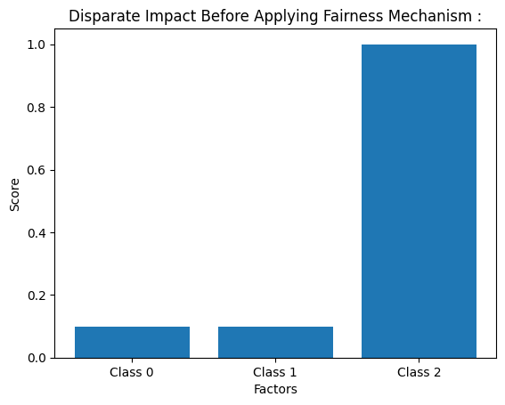
Fitting MACHINE LEARNING MODELS
LOGISTIC REGRESSION

Slide 14
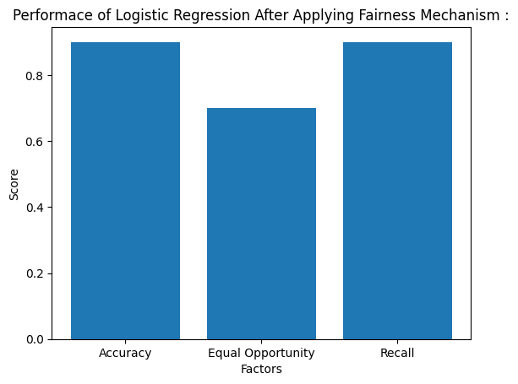
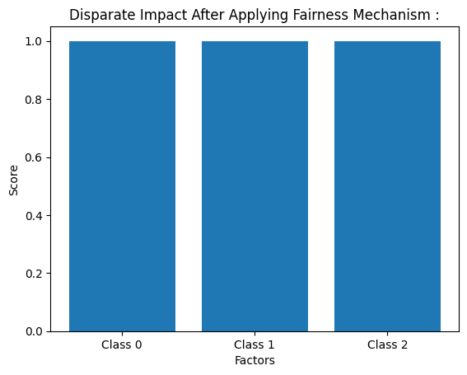

Slide 15
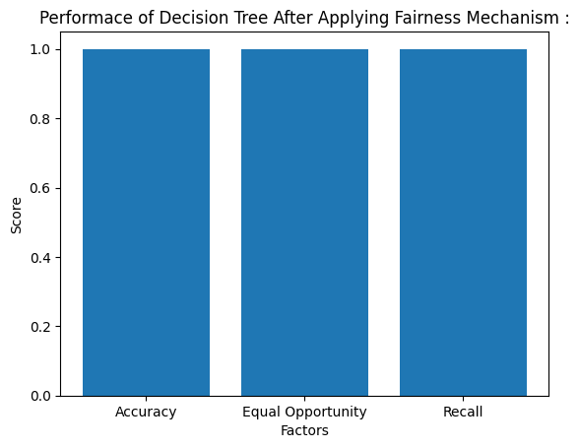
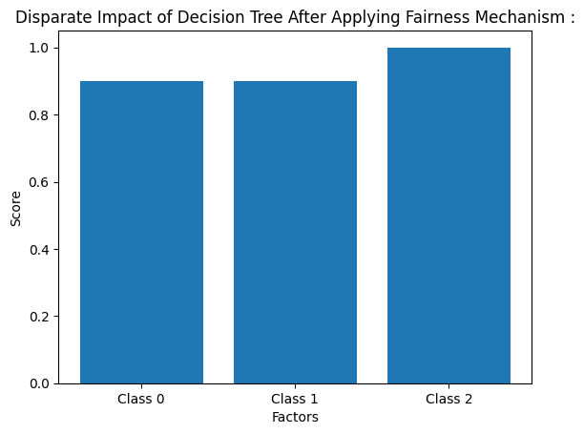
2. DECISION TREE

Slide 16
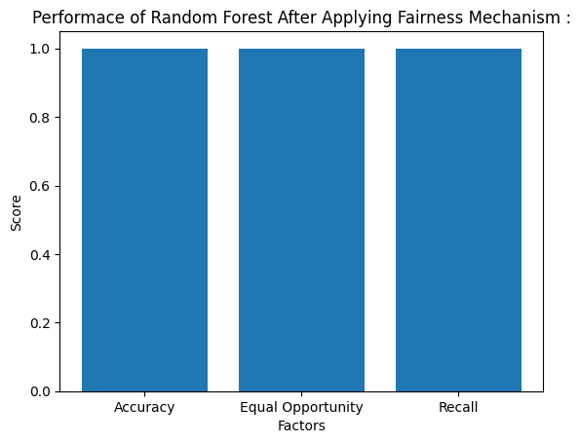
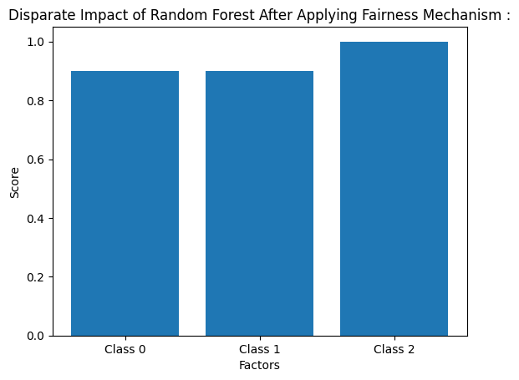
3. Random forest

Slide 17
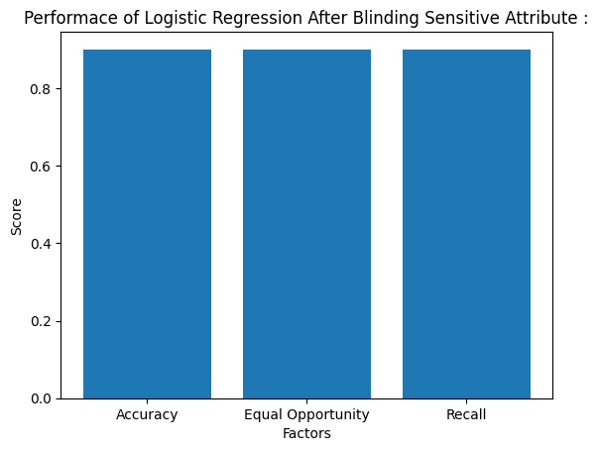

After blinding sensitive attributes

Slide 18
Dataset2 : compas recidivism racial bias
COMPAS (Correctional Offender Management Profiling for Alternative Sanctions) is a popular commercial algorithm used by judges and parole officers for scoring criminal defendant’s likelihood of reoffending (recidivism). It has been shown that the algorithm is biased in favor of white defendants, and against black inmates, based on a 2 year follow up study (i.e who actually committed crimes or violent crimes after 2 years). The pattern of mistakes, as measured by precision/sensitivity is notable.

Slide 19
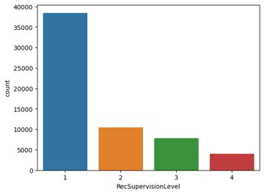
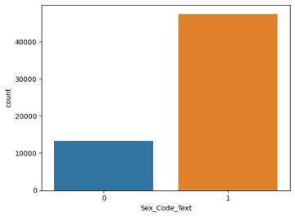
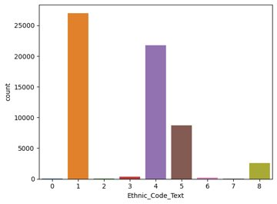
ANALYSING THE DATASET2:
The dataset includes information on individuals who were scored by the COMPAS algorithm in Broward County, Florida, and includes information on race, gender, age, prior criminal history, and whether or not the individual was rearrested within two years of their initial arrest.
The dataset has been found to exhibit racial bias in the scores assigned by the COMPAS algorithm, with Black defendants being more likely to receive higher risk scores than White defendants, even when controlling for other factors such as prior criminal history.

Slide 20
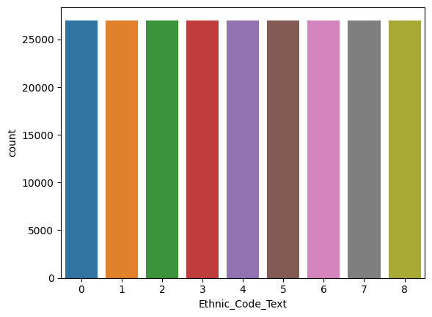
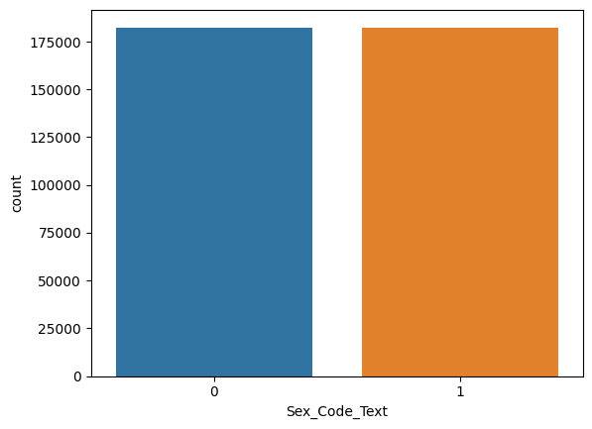
RESAMPLING THE DATASET2:

Slide 21
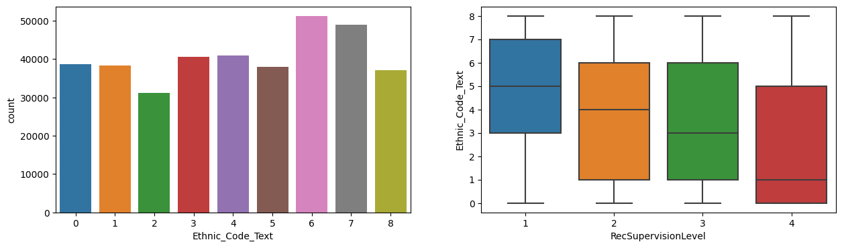
1-Factor analysis
Factor analysis is a statistical technique used to identify underlying dimensions or factors that explain the correlations among a set of observed variables.
RELATIONSHIP BETWEEN Ethnicity and RecSupervisionLevel
RecSupervisionLevel : refers to the level of supervision that an individual is assigned to after being released from prison

Slide 22
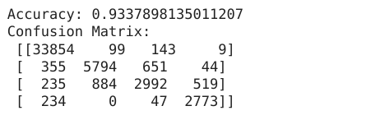
Evaluating logistic regression

Slide 23
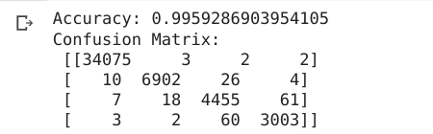
Evaluating decision tree

Slide 24
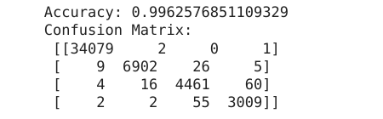
Evaluating random forest

Slide 25
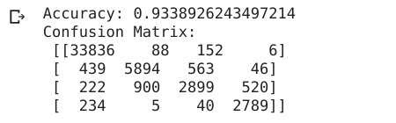
Evaluating logistic regression (blinded testing)

Slide 26
Confusion matrix analysis
33,836 individuals were predicted to be at low risk of recidivism, and did not in fact recidivate (True Negative).
88 individuals were predicted to be at low risk of recidivism, but did in fact recidivate (False Negative).
152 individuals were predicted to be at medium risk of recidivism, and did not in fact recidivate (True Negative).
6 individuals were predicted to be at medium risk of recidivism, but did in fact recidivate (False Negative).
439 individuals were predicted to be at high risk of recidivism, and did not in fact recidivate (False Positive).
5,894 individuals were predicted to be at high risk of recidivism, and did in fact recidivate (True Positive).
563 individuals were predicted to be at very high risk of recidivism, and did not in fact recidivate (True Negative).
46 individuals were predicted to be at very high risk of recidivism, but did in fact recidivate (False Negative).
222 individuals were predicted to be at low risk of recidivism, but did in fact recidivate (False Negative).
900 individuals were predicted to be at medium risk of recidivism, and did in fact recidivate (False Positive).
2,899 individuals were predicted to be at high risk of recidivism, and did in fact recidivate (True Positive).
520 individuals were predicted to be at very high risk of recidivism, and did in fact recidivate (True Positive).
234 individuals were not assessed for risk, and did not in fact recidivate (True Negative).
5 individuals were not assessed for risk, but did in fact recidivate (False Negative).
40 individuals were not assessed for risk, and did not in fact recidivate (True Negative).
2,789 individuals were not assessed for risk, and did in fact recidivate (True Positive).

Slide 27
Conclusion
So we have achieved fairness using techniques like upsampling, reweighning and blinding sensitive attributes.

